Slide 1
What Is The Effect Of The Earth's Temperature on Cyclonic Storms?
Keeno Glanville

Slide 2
AGENDA
Introduction
Historic Temperatures
Recent Temperatures
Occurrence of Natural Disasters
Recent Natural Disasters
Comparison

Slide 3
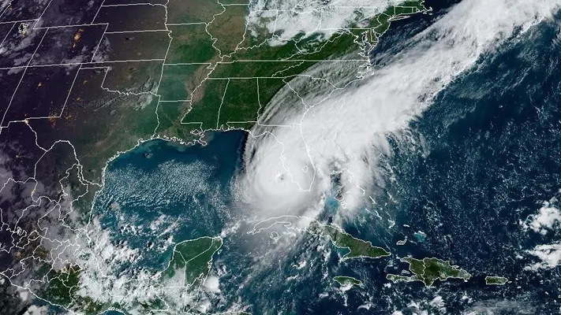
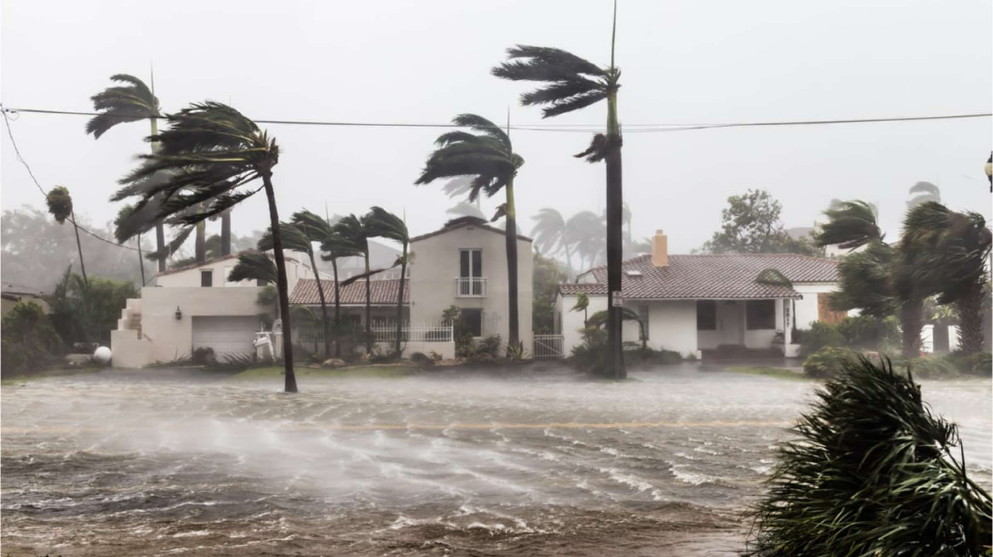
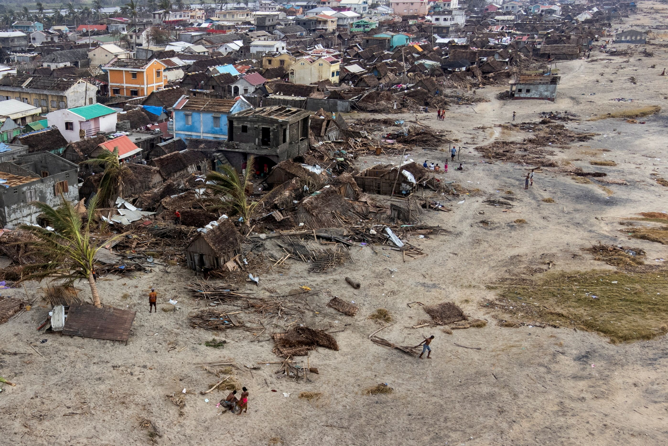
INTRODUCTION
As our climate undergoes significant changes, it becomes crucial to understand the influence of rising temperatures on the frequency and intensity of cyclonic storms, including hurricanes, typhoons, and tornadoes.

Slide 4
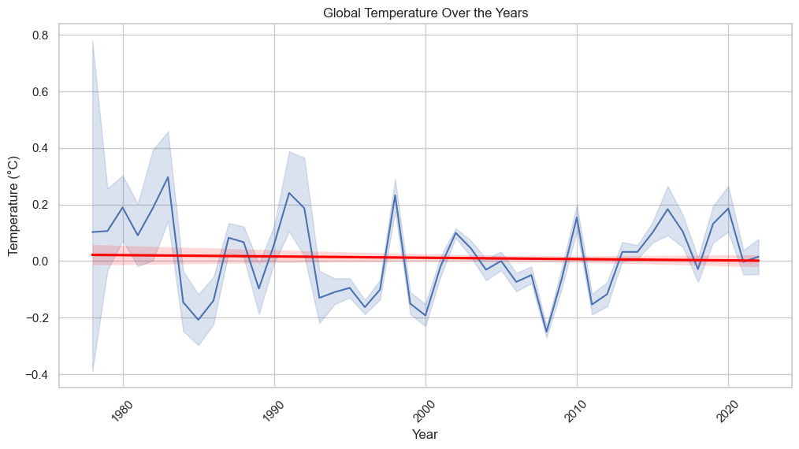
Historic temperatures
Historically this graph demonstrates that temperatures are on the decline or steady. This is interesting because is global warming really on the rise? This is interesting seeing that temperatures were even strongly elevated in the 1970s

Slide 5
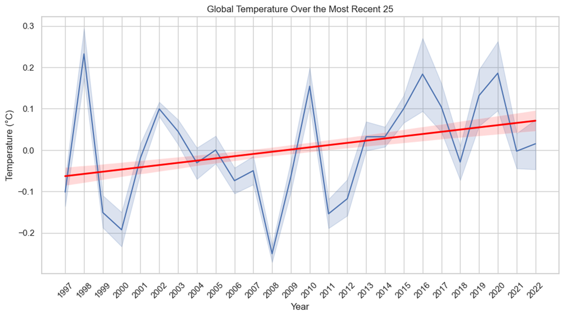
Historic temperatures
Zoning into the previous 25 years, we see that there is actually a rise in temperatures. How does this affect the occurrence of natural disasters?

Slide 6
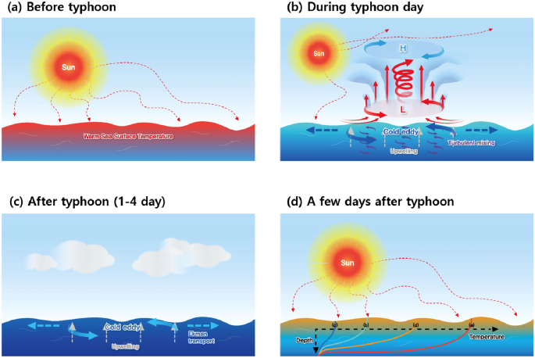
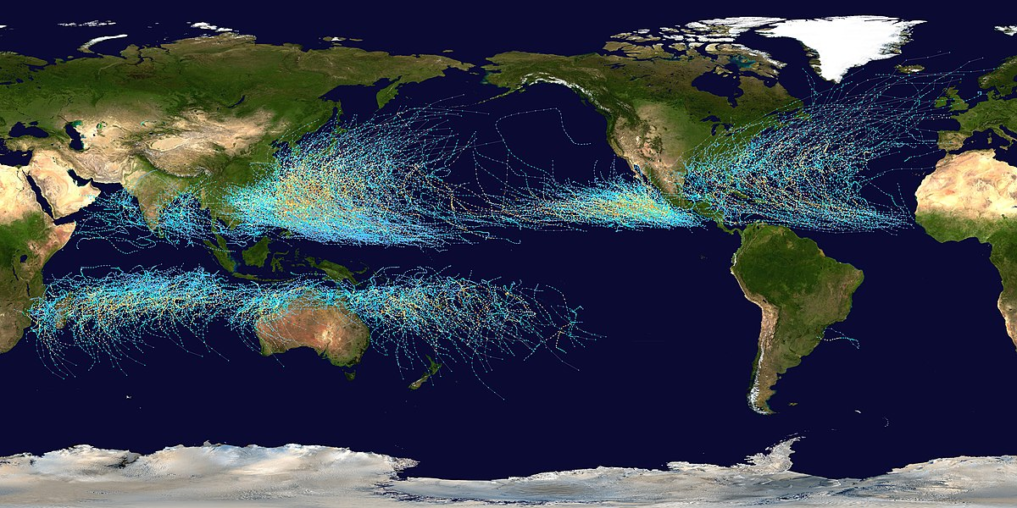
How do cyclonic disasters work?
Cyclonic disasters, such as hurricanes, typhoons, and tornadoes, form through the complex interplay of warm ocean waters, atmospheric instability, and low-pressure systems. As warm air over the ocean surface rises, it creates a low-pressure area that draws in more air, initiating a spiraling motion. This evolving system gains energy from the warm ocean, intensifying into a cyclonic storm with destructive winds and precipitation.

Slide 7
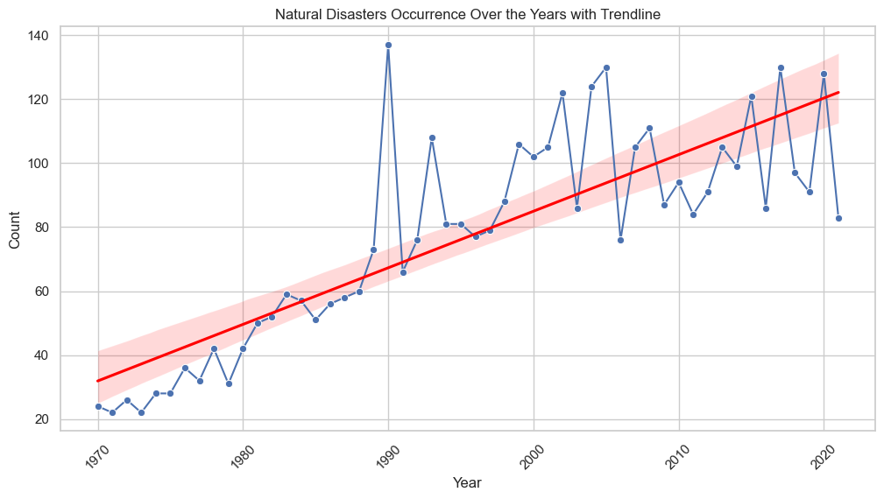
Occurrence of cyclonic disasters over the years
We see that over the years, especially the most recent 25, cyclonic disasters are starting to increase tremendously
Richard Branson

Slide 8
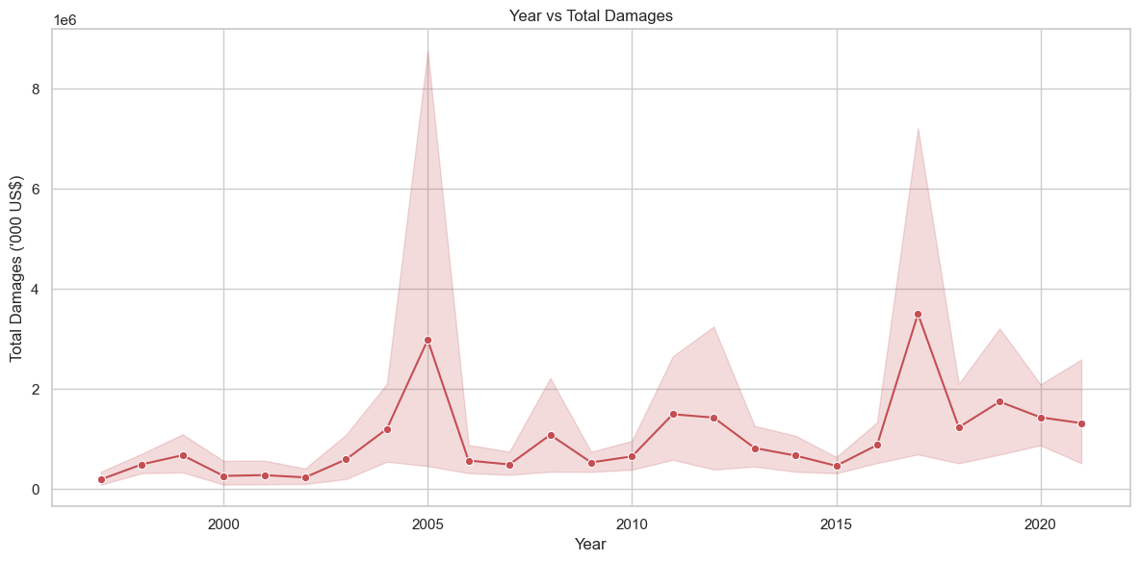
Severity of cyclonic disasters
The damages caused by these disasters are on the rise

Slide 9
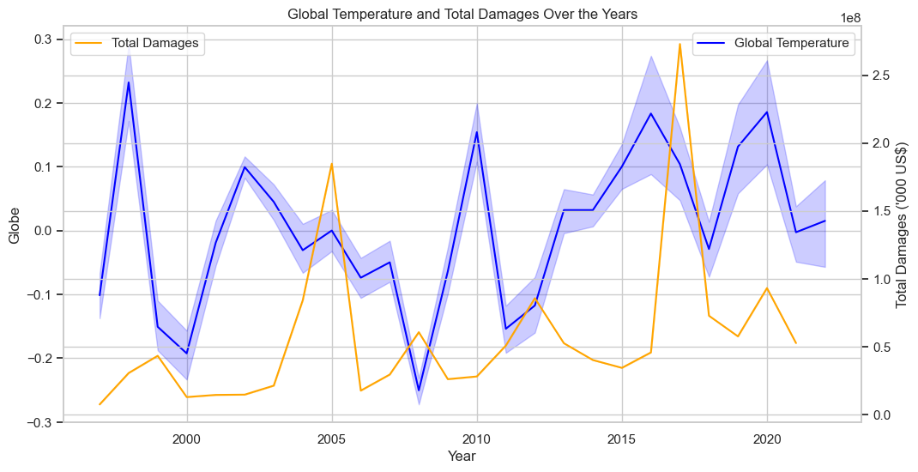
The effect of global temperatures on cyclonic disasters

Slide 10
Conclusion
In conclusion, the observed increase in global temperatures correlates with a notable uptick in the frequency and severity of cyclonic events. The escalating temperatures contribute to the intensification of these storms, underscoring the urgent need for climate mitigation and adaptation strategies to address the growing impact of cyclonic disasters on our planet.

